Slide 1

Introduction to Backend-as-a-service
Otniel Yosi Viktorisa
Product Developer Team Lead at PT. Altrovis Tekno Global
otniel.y.viktorisa@gmail.com

Slide 2
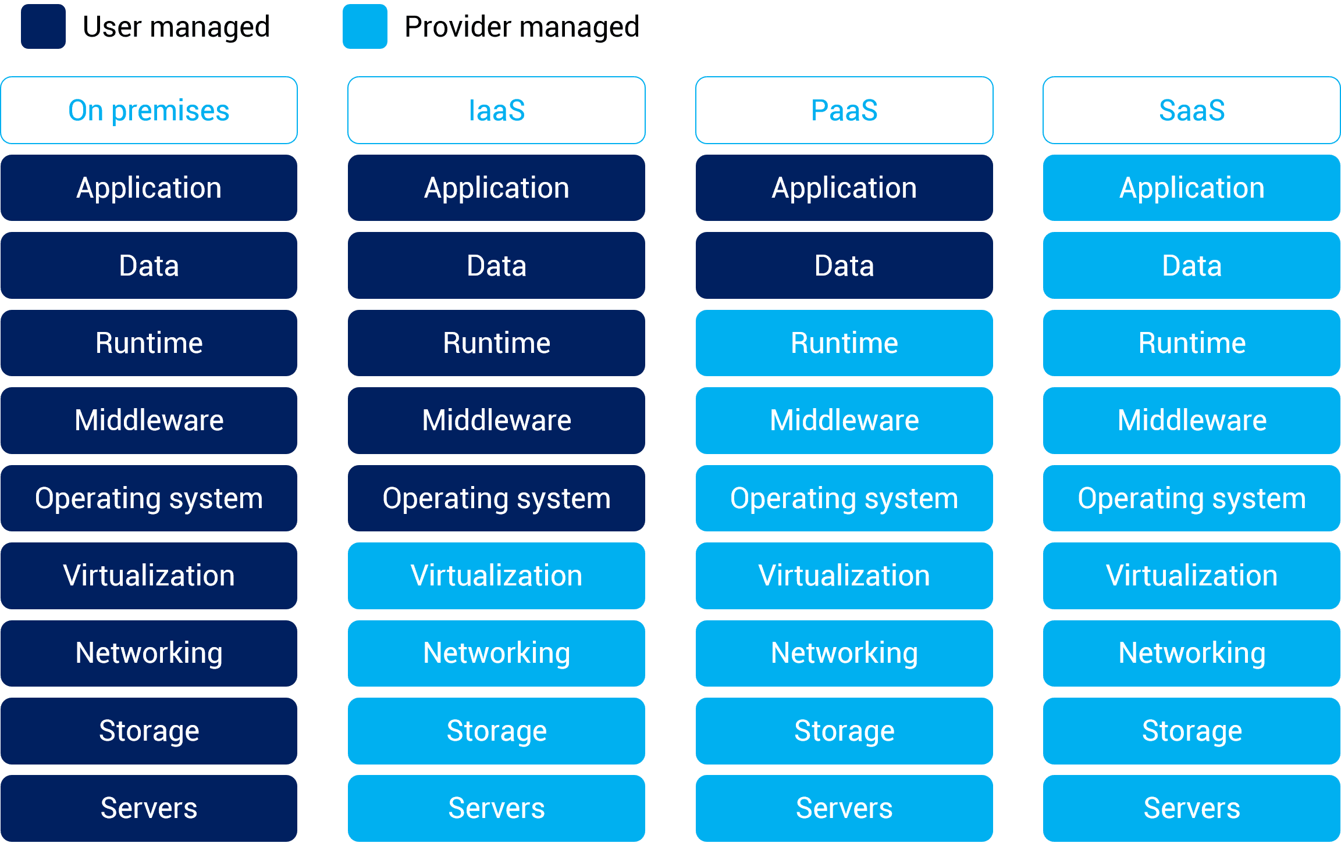
Service types
Image:https://www.alibabacloud.com/knowledge/difference-between-iaas-paas-saas

Slide 3
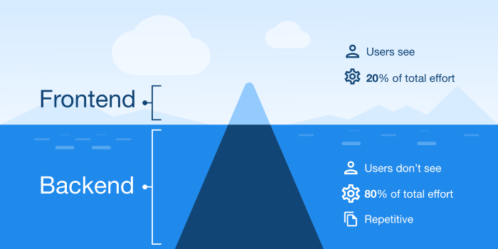
Why Backend-as-a-Service
Image: https://george-51059.medium.com/backend-as-a-service-list-9104bdce845e

Slide 4
Backend-as-a-Service
Cloud-hosted backend functionality package
Can also serve as a middleware

Slide 5
Benefits
Speed
Scalability
Guaranteed performance

Slide 6
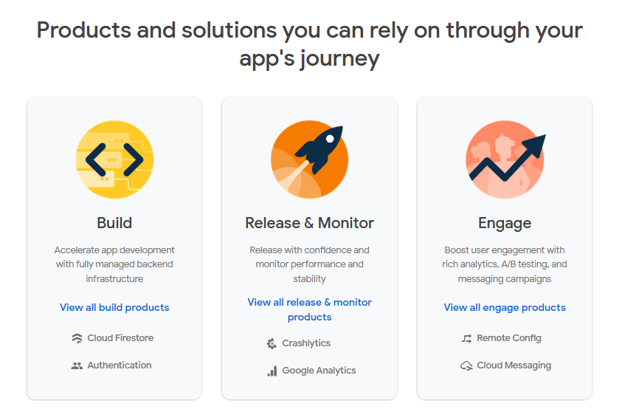
BaaS Provider – Google Firebase

Slide 7
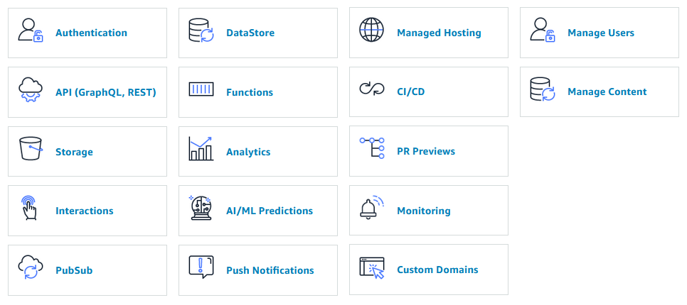
BaaS Provider – AWS Amplify

Slide 8
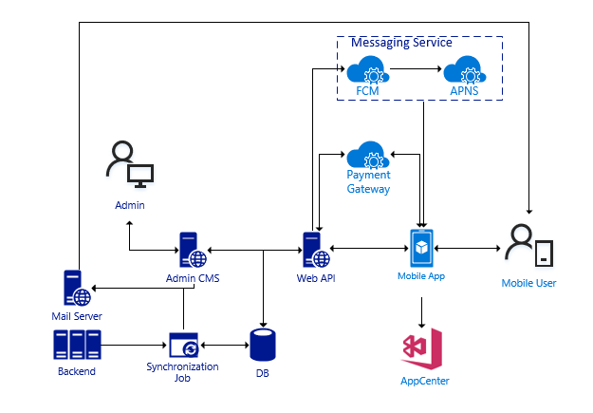
Case study

Slide 9
Resources
Flutter-Firebase starter project by Andrea (https://codewithandrea.com/videos/starter-architecture-flutter-firebase/)

